Slide 1

Video Processing in Matlab
Marking White Car in a traffic Video
Cmput 307

Slide 2

Step 1: Access Video with VideoReader
The VideoReader function constructs a multimedia reader object that can read video data from a multimedia file.
trafficVid = VideoReader('traffic.mj2')

Slide 3
Step 1: Access Video with VideoReader
The get method provides more information on the video such as its duration in seconds.
get(trafficVid)
VideoReader with properties:
General Properties:
Name: 'traffic.mj2‘
Path: '/mathworks/devel/bat/Bdoc16b/build/matlab/toolbox/image...'
Duration: 8
CurrentTime: 0
Tag: '' UserData: []
Video Properties: Width: 160 Height: 120 FrameRate: 15 BitsPerPixel: 24 VideoFormat: 'RGB24'

Slide 4
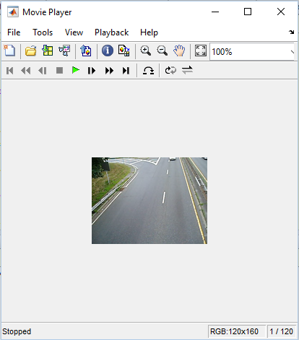

Step 2: Explore Video with IMPLAY
Explore the video in implay.
implay('traffic.mj2');
Playing the Video

Slide 5

Step 3: Develop Your Algorithm
A representative frame from the video and develop your algorithm on that frame
Then, this algorithm can be applied to the processing of all the frames in the video.
%% For removing the dark cars with this thresholding functuion
darkCarValue = 50;
darkCar = rgb2gray(read(trafficVid,71));
noDarkCar = imextendedmax(darkCar, darkCarValue);
imshow(darkCar)
figure, imshow(darkCar)
%% remove remaining lane-markings point that are should not include in the result by morphological processing
sedisk = strel('disk',2);
noSmallStructures = imopen(noDarkCar, sedisk);
imshow(noSmallStructures)

Slide 6
Step 4: Apply the Algorithm to the Video
The car-tagging application processes the video one frame at a time in a loop.
nframes = trafficVid.NumberOfFrames;
I = read(trafficVid, 1);
taggedCars = zeros([size(I,1) size(I,2) 3 nframes], class(I));
for k = 1 : nframes
singleFrame = read(trafficVid, k);
% Convert to grayscale to do morphological processing.
I = rgb2gray(singleFrame);
% Remove dark cars.
noDarkCars = imextendedmax(I, darkCarValue);
% Remove lane markings and other non-disk shaped structures.
noSmallStructures = imopen(noDarkCars, sedisk);
% Remove small structures.
noSmallStructures = bwareaopen(noSmallStructures, 150);
taggedCars(:,:,:,k) = singleFrame;
stats = regionprops(noSmallStructures, {'Centroid','Area'});
if ~isempty([stats.Area])
areaArray = [stats.Area];
[junk,idx] = max(areaArray);
c = stats(idx).Centroid;
c = floor(fliplr(c));
width = 2;
row = c(1)-width:c(1)+width;
col = c(2)-width:c(2)+width;
taggedCars(row,col,1,k) = 255;
taggedCars(row,col,2,k) = 0;
taggedCars(row,col,3,k) = 0;
end
end
The number of frames in the video!
Tagging the White Car after extracting them from each frame!

Slide 7
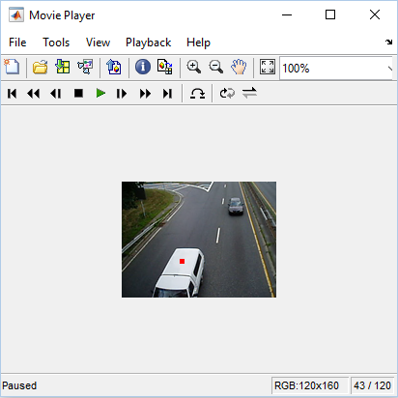
Step 5: Visualize Results
Get the frame rate of the original video and use it to see taggedCars in implay.
frameRate = trafficVid.FrameRate; implay(taggedCars,frameRate);

